Slide 1
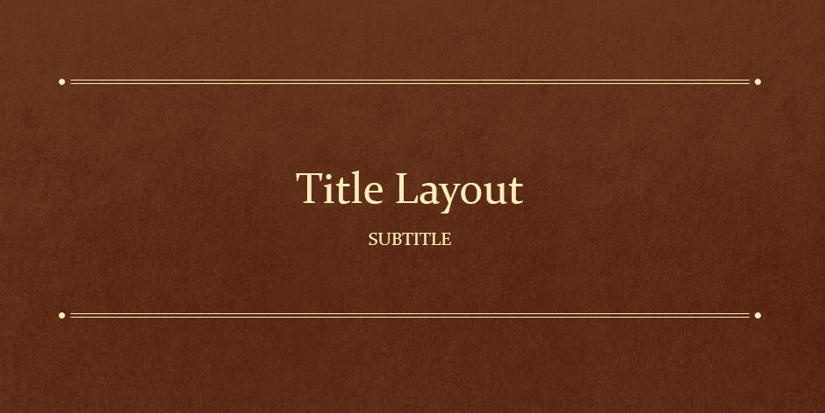

LE CERCLE DES SCRIBOUILLARDS volume 1

Slide 2
Le Cercle des scribouillards
Comment les cours de génie logiciel nous ont-ils aidés à mener à bien le projet?

Slide 3
SOMMAIRE 1 Lien entre la théorie et la pratique 2 Organisation et mise en place 3 Problème rencontrés, solutions trouvées 4 Points perfectibles, restes à faire, points non solutionnés

Slide 4




Lien entre la théorie et la pratique
😉

Slide 5
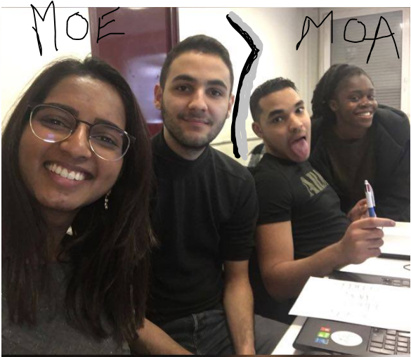
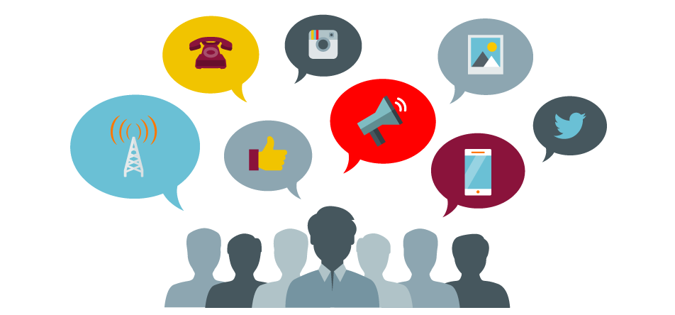


Organisation et mise en place
Séparation de l’équipe en 2
Communication

Slide 6



Problème rencontrés, solutions trouvées
 | Organisation | Spring boot | Test unitaire | Sonar Cloud
Difficulté | Recherche d’une méthode de travail adaptée. | Utilisation globale. | Résolution des dépendances des classes à tester. | Mise en place de l’intégration continue.
Méthode et Solution | Division de l’équipe. Recherche de tutoriel sur l’outil Trello et entraide. Mise en place d’un tableau de bord. | Recherches et tri sur les résultats. | Utilisation de la documentation Springboot. Utilisation des annotations « Mockito »,« when », « then »... | Compte Sonar. Utilisation de Travis.

Slide 7
Quotations are commonly printed as a means of inspiration and to invoke philosophical thoughts from the reader.

Slide 8
THIS IS A SLIDE TITLE
Here you have a list of items
And some text
But remember not to overload your slides with content
Your audience will listen to you or read the content, but won’t do both.

Slide 9
BIG CONCEPT
Bring the attention of your audience over a key concept using icons or illustrations

Slide 10
YOU CAN ALSO SPLIT YOUR CONTENT
White
Is the color of milk and fresh snow, the color produced by the combination of all the colors of the visible spectrum.
Black
Is the color of coal, ebony, and of outer space. It is the darkest color, the result of the absence of or complete absorption of light.

Slide 11
IN 2 OR 3 COLUMNS
Yellow
Is the color of gold, butter and ripe lemons. In the spectrum of visible light, yellow is found between green and orange.
Blue
Is the colour of the clear sky and the deep sea. It is located between violet and green on the optical spectrum.
Red
Is the color of blood, and because of this it has historically been associated with sacrifice, danger and courage.

Slide 12
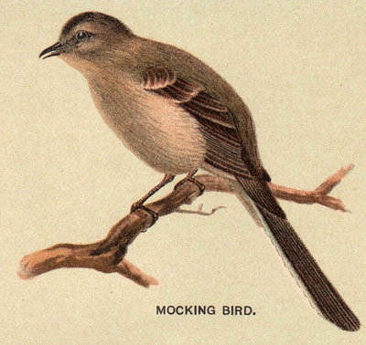
A PICTURE IS WORTH A THOUSAND WORDS
A complex idea can be conveyed with just a single still image, namely making it possible to absorb large amounts of data quickly.

Slide 13
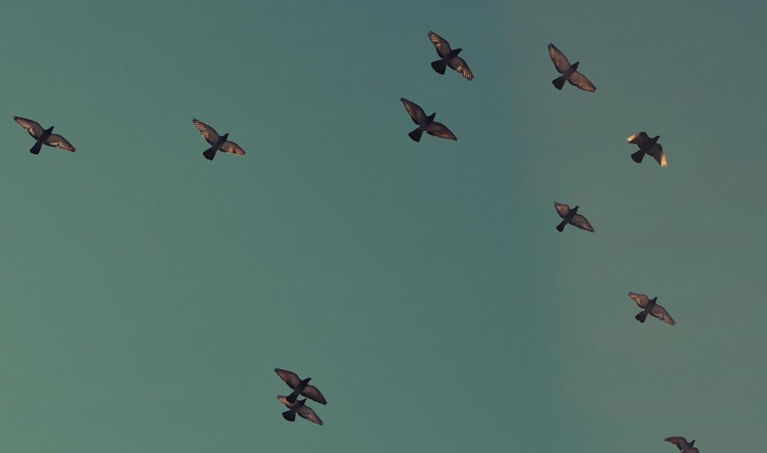
Want big impact?
USE BIG IMAGE

Slide 14
USE CHARTS TO EXPLAIN YOUR IDEAS
White
Gray
Black

Slide 15
AND TABLES TO COMPARE DATA
 | A | B | C
Yellow | 10 | 20 | 7
Blue | 30 | 15 | 10
Orange | 5 | 24 | 16

Slide 16
MAPS
our office

Slide 17
89,526,124
Whoa! That’s a big number, aren’t you proud?

Slide 18
89,526,124$
185,244 users
100%
That’s a lot of money
And a lot of users
Total success!

Slide 19
OUR PROCESS IS EASY
first
second
last

Slide 20
LET’S REVIEW SOME CONCEPTS
Yellow
Is the color of gold, butter and ripe lemons. In the spectrum of visible light, yellow is found between green and orange.
Blue
Is the colour of the clear sky and the deep sea. It is located between violet and green on the optical spectrum.
Red
Is the color of blood, and because of this it has historically been associated with sacrifice, danger and courage.
Yellow
Is the color of gold, butter and ripe lemons. In the spectrum of visible light, yellow is found between green and orange.
Blue
Is the colour of the clear sky and the deep sea. It is located between violet and green on the optical spectrum.
Red
Is the color of blood, and because of this it has historically been associated with sacrifice, danger and courage.

Slide 21
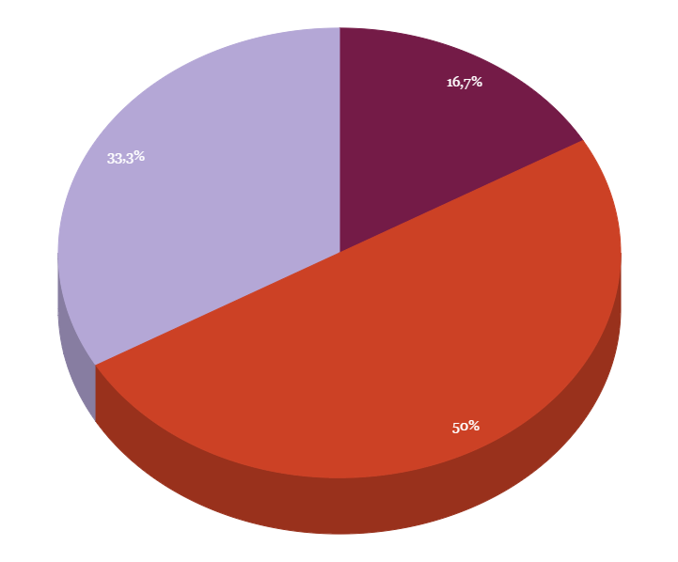
You can insert graphs from Google Sheets

Slide 22
ANDROID PROJECT
Show and explain your web, app or software projects using these gadget templates.
Place your screenshot here

Slide 23
iPHONE PROJECT
Show and explain your web, app or software projects using these gadget templates.
Place your screenshot here

Slide 24
TABLET PROJECT
Show and explain your web, app or software projects using these gadget templates.
Place your screenshot here

Slide 25
DESKTOP PROJECT
Show and explain your web, app or software projects using these gadget templates.
Place your screenshot here

Slide 26

THANKS!
Any questions?
You can find me at @username & user@mail.me

Slide 27
CREDITS
Special thanks to all the people who made and released these awesome resources for free:
Presentation template by SlidesCarnival
Photographs by Unsplash

Slide 28
PRESENTATION DESIGN
This presentation uses the following typographies and colors:
Titles: Oswald
Body copy: Tinos
You can download the fonts on this pages:
https://www.fontsquirrel.com/fonts/oswald · https://www.fontsquirrel.com/fonts/tinos
You don’t need to keep this slide in your presentation. It’s only here to serve you as a design guide if you need to create new slides or download the fonts to edit the presentation in PowerPoint®

Slide 29
SlidesCarnival icons are editable shapes.
This means that you can:
Resize them without losing quality.
Change fill color and opacity.
Isn’t that nice? :)
Examples:

Slide 30
😉
Now you can use any emoji as an icon!
And of course it resizes without losing quality and you can change the color.
How? Follow Google instructions https://twitter.com/googledocs/status/730087240156643328
✋👆👉👍👤👦👧👨👩👪💃🏃💑❤😂😉😋😒😭👶😸🐟🍒🍔💣📌📖🔨🎃🎈🎨🏈🏰🌏🔌🔑 and many more...

